Slide 1

Project Concept Presentation Umar Hoshimov Webster University COSC 2110: Computer Languages Prof. Sanjar Bekov October 16, 2024

Slide 2

AGENDA
Project Overview
Problem Statement
Proposed Solution
System Architecture / Workflow
Project Roadmap

Slide 3

Assignment Submission Telegram Bot

Slide 4

Telegram bot designed to help teachers avoid overcrowded chats, keep transparency and privacy.
Project Overview

Slide 5

Problem Statement
Private teachers struggle to manage connection between every student they have.
Answering to each student chat.
Privacy in group chats.
Teacher contact information privacy

Slide 6
Proposed Solution
Technologies used:
Python
Aiogram3
Database (for user authentication):
SQLite3
JSON
Key Features:
Sending files directly to the teacher.
Teacher’s individual responds and comments.
Access management.
No savings on server. For privacy matters.

Slide 7
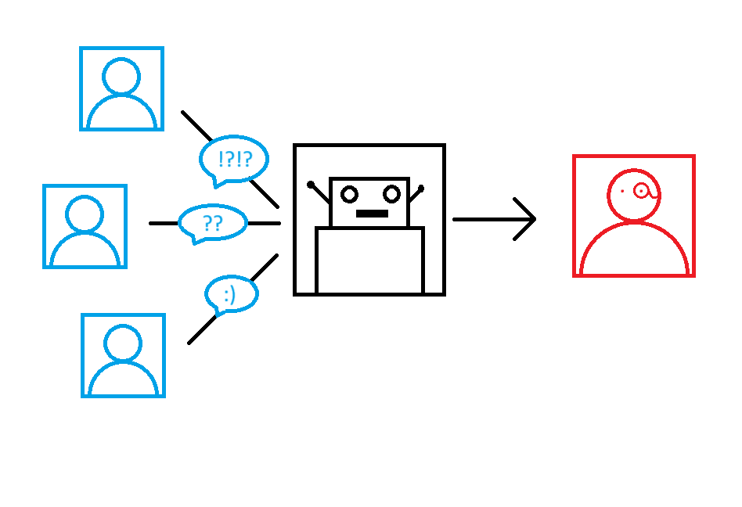
System Architecture / Workflow

Slide 8
Project Roadmap
Phase 1: Research and planning - 1 week
Phase 2: Development of the core features - 2 weeks
Phase 3: Beta testing with user feedback – 1 weeks
Phase 4: Fixing and additional requirements – 2 weeks
Phase 4: Full launch and stability analysis – 2 weeks
Risks:
Managing unsupported file type/extension.
User adaptation.
Server stability.
Data loss.

Slide 9

Expected Outcomes & Impact
A fully functioning bot. Which can provide transparent teacher-student communication.
Students will have comprehensive and easy-to-use chat to submit their files.

Slide 10

Future improvements
Saving data on server in encrypted form
User registration and apply form
Student activity rate records

Slide 11

THANK YOU
Umar Hoshimov
Email: umarhoshimov@webster.edu
GitHub: https://github.com/Master2907

